Slide 1
Instructor for Vue Router and Load JSON File

Slide 2
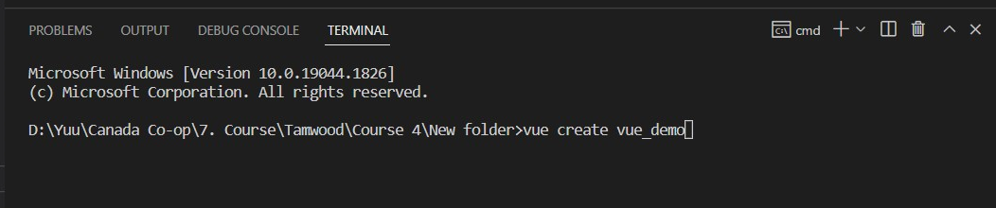
Create new Vue application file
Step 1: Create Vue project
>> in VS code
>> Terminal (remember!!! Need to change to “Command Prompt<cmd>”)
>> Type: vue create file_name
file_name(whatever you want)

Slide 3
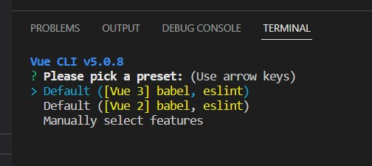
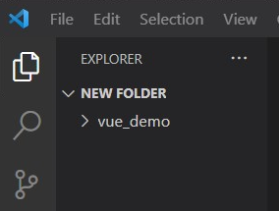
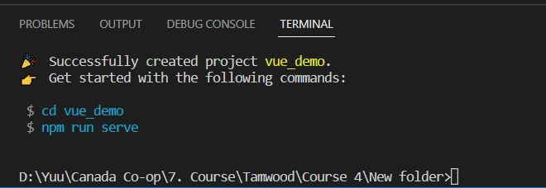
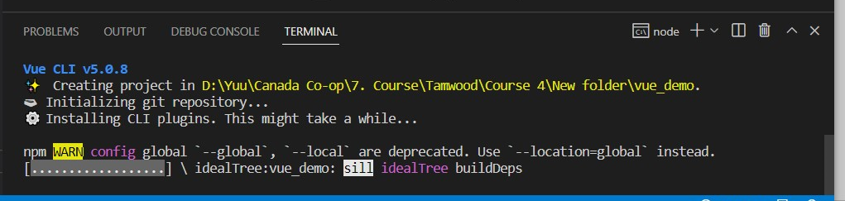
Create new Vue application file
Step 2: Choose Default ([Vue 3] babel, eslint) to create
>> after choose Vue 3 to create need to wait program run for few minutes
>> if success will show “Successfully…”, you also can saw the now folder
1
3
2

Slide 4
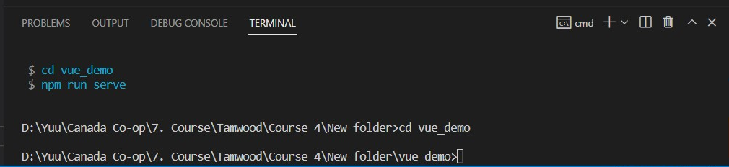
Create new Vue application file
Step 3: switch to new Vue project folder
>> Type: cd file_name
>> remember!!! Must switch to the project you just create
file_name(you just created)
Switch success

Slide 5
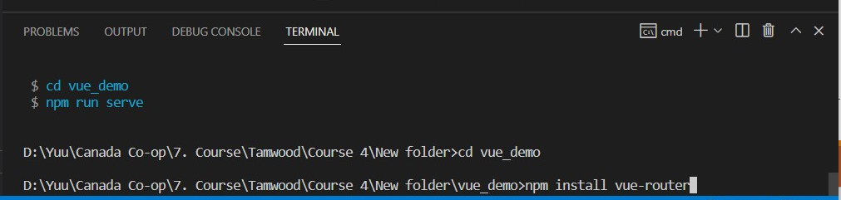
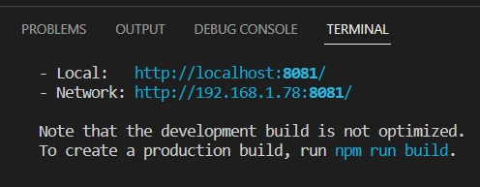
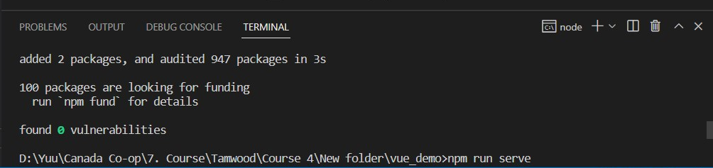
Create Vue Router
Step 1: Install router pkg
>> Type: npm install vue-router
>> Test run check --Type: npm run serve
1
2
success

Slide 6
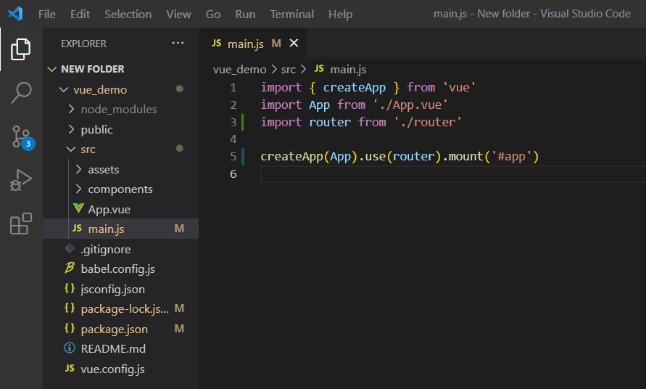
Create Vue Router
Step 2: Modify main.js file to link router
>> go to main.js file
>> Add: import router from ‘./router’
>> Modify: createApp(App).use(router).mount(‘#app’)

Slide 7
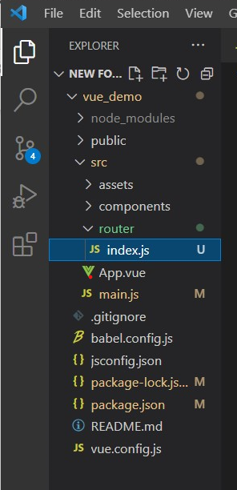
Create Vue Router
Step 3: Create router folder and index.js(for route logic)
>> under the src folder, create new folder “router”
>> under router folder, create new file “index.js”

Slide 8
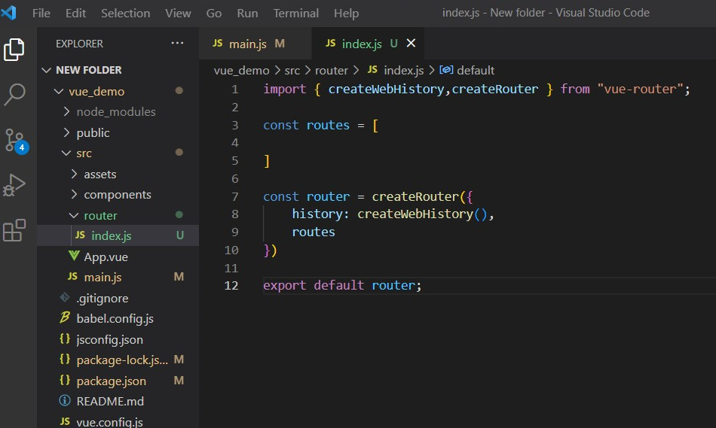
Create Vue Router
Step 4: Edit index.js
>> Type:
import { createWebHistory,createRouter } from "vue-router";
const routes = [
]
const router = createRouter({
history: createWebHistory(),
routes
})
export default router;
correspond
routes will define later
correspond

Slide 9
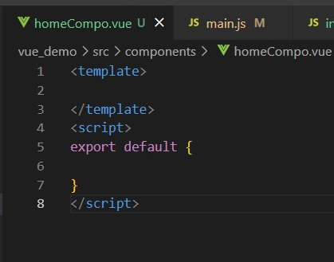
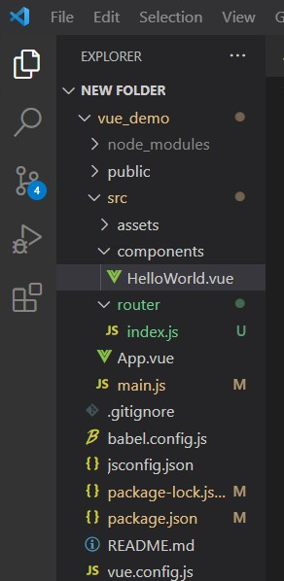
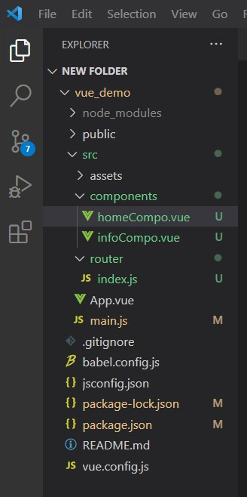
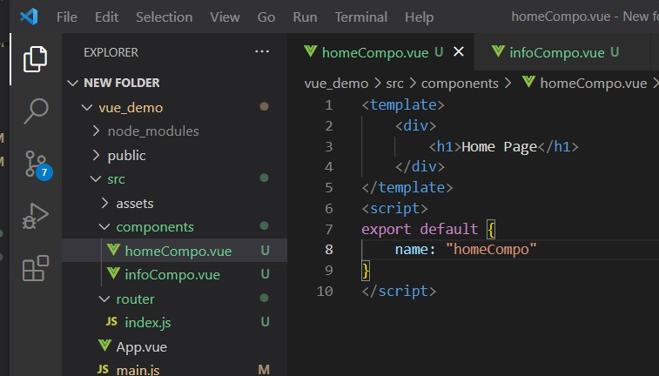
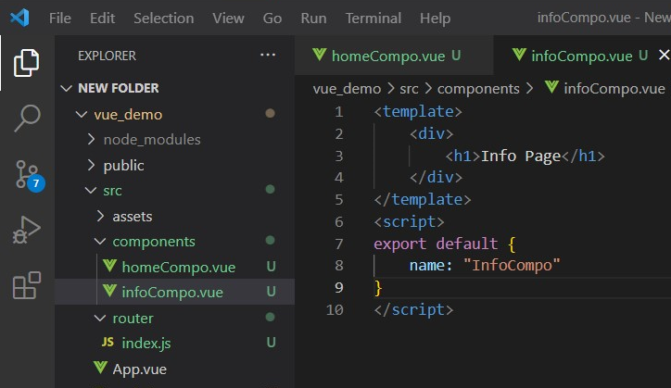
Create Vue Router
component.vue file
standard format
Step 5: Create component for different page
>> under components folder delete “HelloWorld” file, create new file.vue (create as many pages as you need for SPA)
>> Edit component.vue file
<template>
<div>
<h1>Home Page</h1>
</div>
</template>
<script>
export default {
name: "homeCompo"
}
</script>
1
2
3
Edit
create
delete
Edit

Slide 10
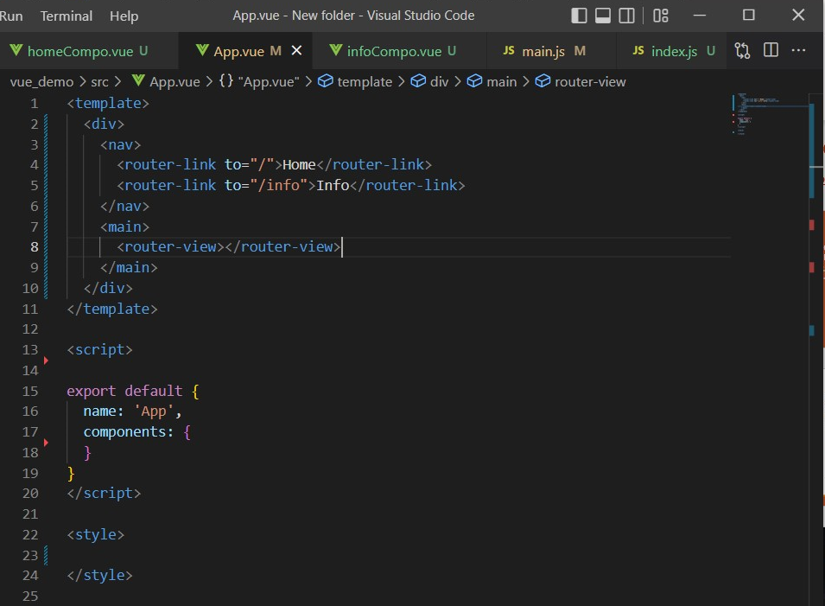
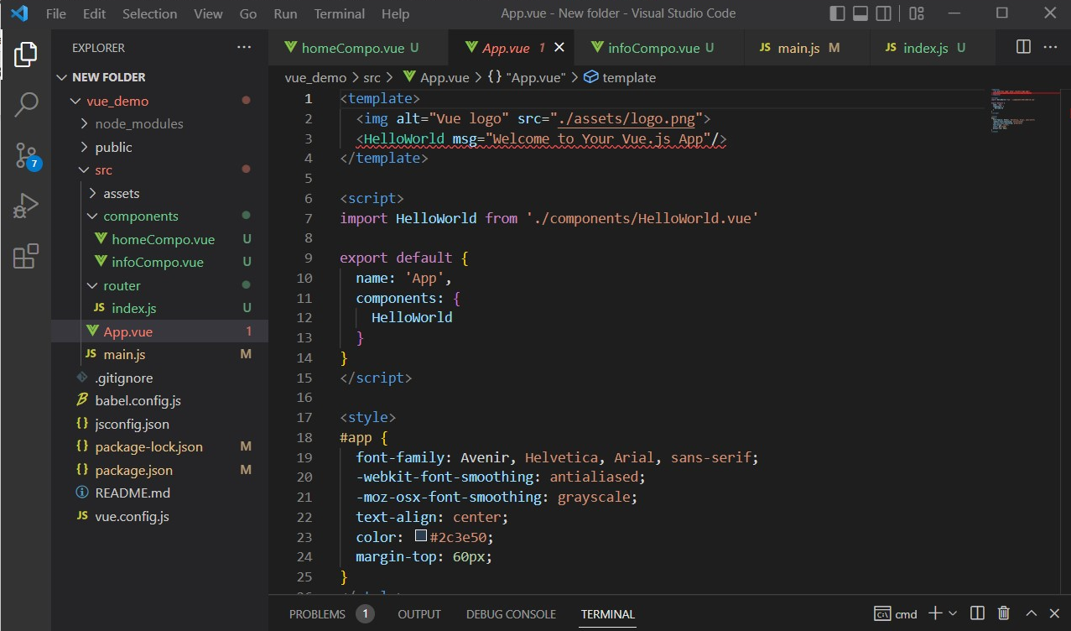
Create Vue Router
Step 6: Edit App.vue for show the content in HTML
>> Edit App.vue file
Edit HTML part as you want
Two important things don’t forget 1. router-link
2. router-view
Must add !!!!

Slide 11
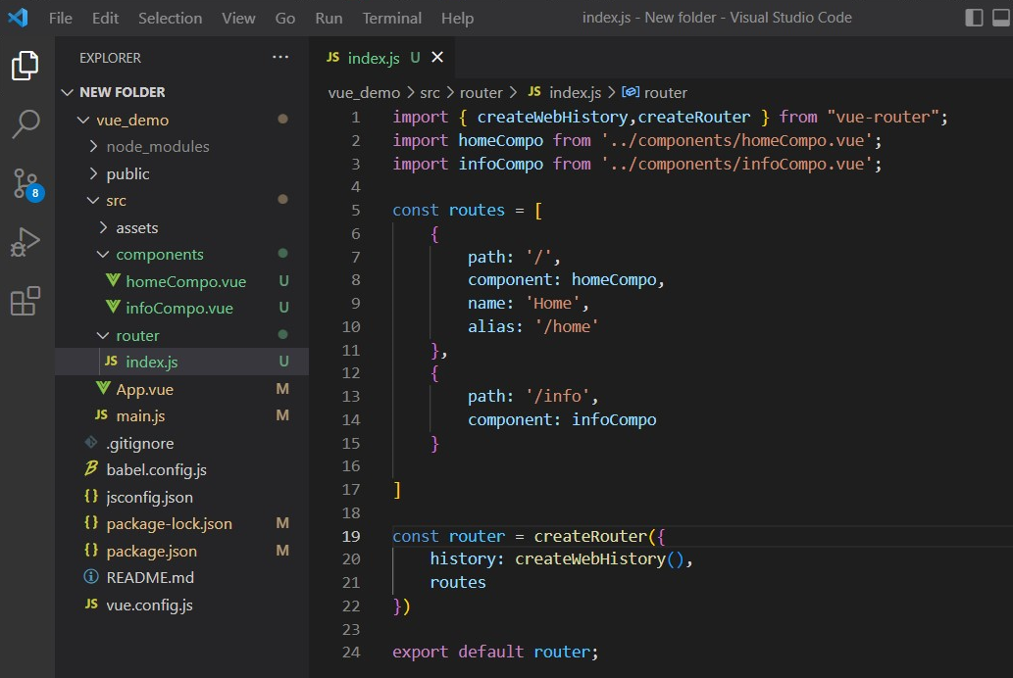
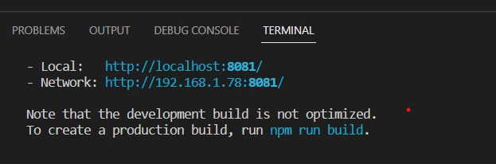
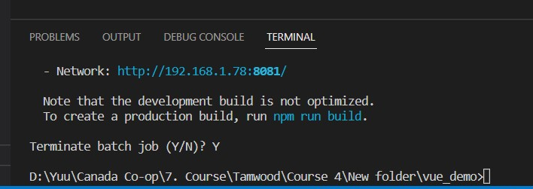
Create Vue Router
Step 7: Import your component to index.js (Link the component page to router)
>> Edit index.js file
>> Add import to link component
>> Define routes
>> Test run check
--Type: npm run serve
import
correspond
check result in HTML
define
name/alias
are not necessary
correspond
Ctrl+C (for windows)to stop run serve
Y

Slide 12
Create Vue Router
import { createWebHistory,createRouter } from "vue-router";
import homeCompo from '../components/homeCompo.vue';
import infoCompo from '../components/infoCompo.vue’;
const routes = [
{
path: '/',
component: homeCompo,
name: 'Home',
alias: '/home'
},
{
path: '/info',
component: infoCompo
} ] const router = createRouter({
history: createWebHistory(),
routes
}) export default router;

Slide 13
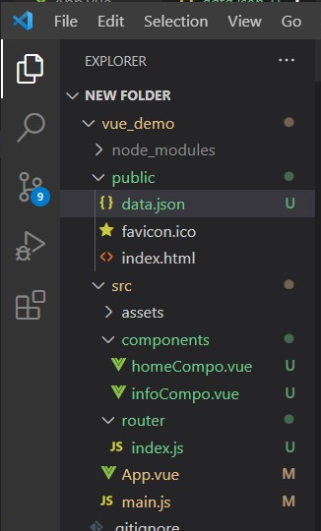
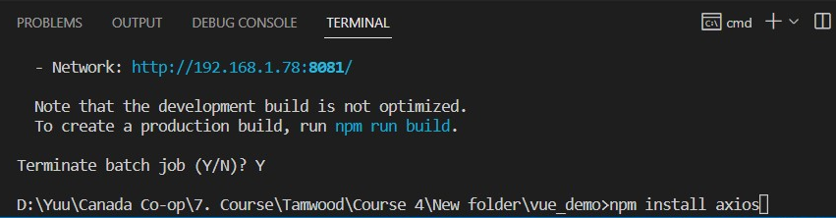
Load JSON File
Step 1: Install axios pkg and pue JSON file into public folder
>> Type: npm install axios
>> JSON file MUST!!! place in public folder
2
1

Slide 14
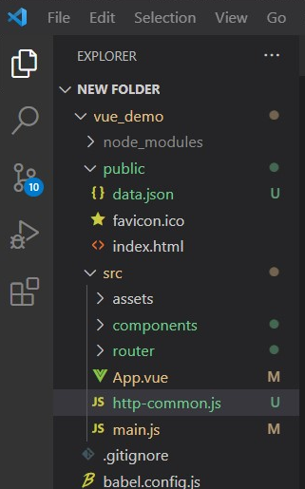
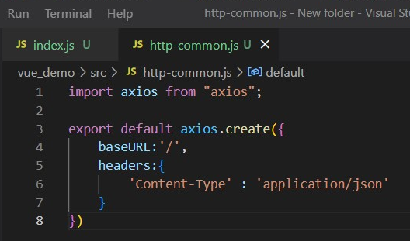
Load JSON File
Step 3: Create and edit http-common.js file(as http request)
>> under the src folder, create new file “http-common.js”
>> Edit http-common.js file
import axios from "axios";
export default axios.create({
baseURL:'/',
headers:{
'Content-Type' : 'application/json'
}
})
1
2

Slide 15
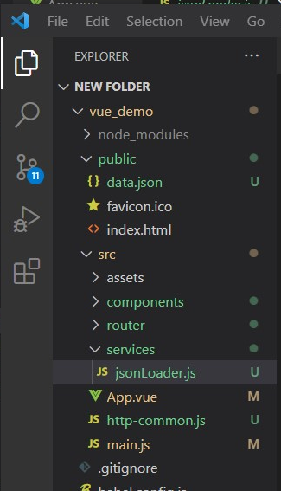
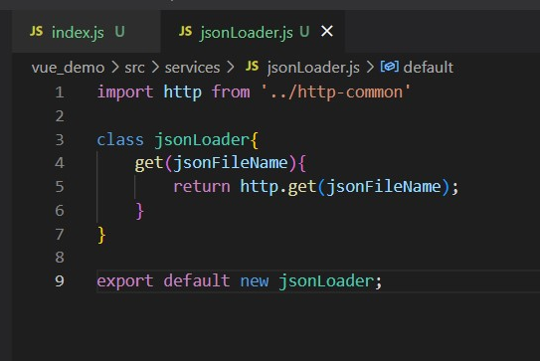
Load JSON File
Step 4: Create services folder and file
>> under the src folder, create new folder “services”
>> under services folder, create new file “jsonLoader.js” then edit (file name can change)
1
2
import http from '../http-common'
class jsonLoader{
get(jsonFileName){
return http.get(jsonFileName);
}
}
export default new jsonLoader;

Slide 16
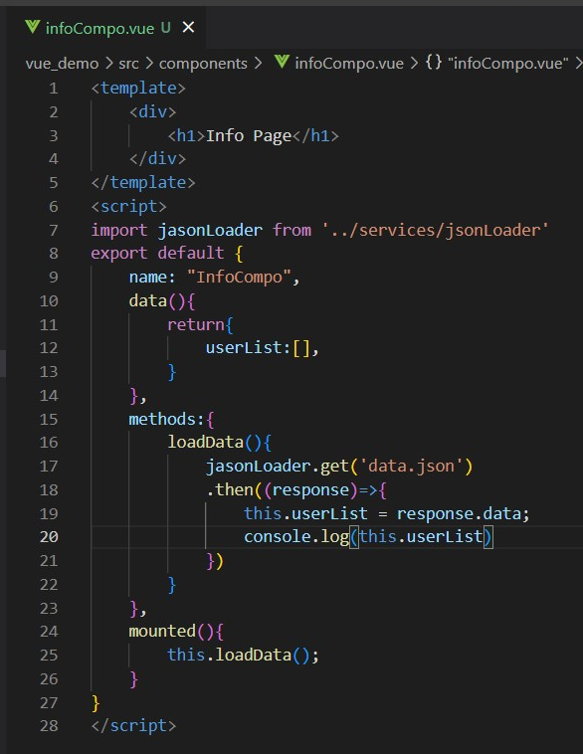
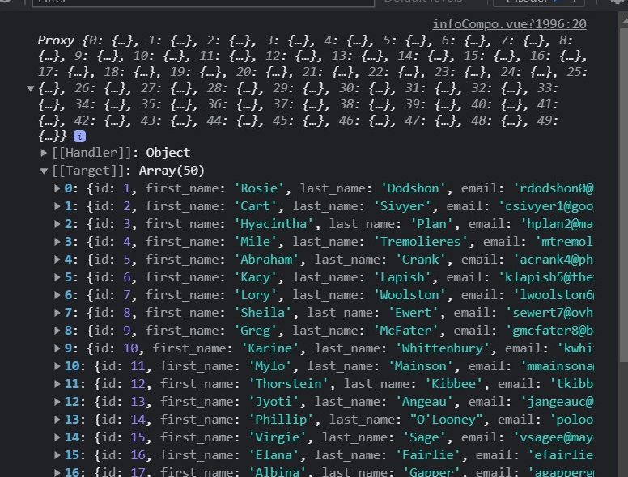
Load JSON File
Step 5: Load the JSON file in page
>> to the component page which you want to show JSON file and edit
>> import jsonLoader
>> add data/methods/mounted
result in console

Slide 17
Load JSON File
<template>
<div>
<h1>Info Page</h1>
</div>
</template>
<script>
import jasonLoader from '../services/jsonLoader'
export default {
name: "InfoCompo",
data(){
return{
userList:[],
}
},
methods:{
loadData(){
jasonLoader.get('data.json')
.then((response)=>{
this.userList = response.data;
console.log(this.userList)
})
}
},
mounted(){
this.loadData();
}
}
</script>

